Slide 1
Medical Transplants Infographics
Here is where this template begins

Slide 2
Medical transplants infographics
Policies
Venus is the second planet from the Sun
Transplant patients
Matching
Donation system
Jupiter is an enormous planet
Living donors
Earth is the third planet from the Sun and the only one that harbors life in the Solar System
Public information
Saturn is a gas giant and has rings
Deceased donors

Slide 3
Medical transplants infographics
Number of organs transplanted per million population
0.1 - 2.4
2.5 - 9.9
10 - 24.9
25 - 49.9
50 - 74.9
75 - 99.9
100+

Slide 4
Medical transplants infographics
Direct donation
Mercury is the closest planet to the Sun and the smallest one
Authorization committee
Saturn was named after the god of wealth and agriculture
DNA typing
Jupiter is the fourth-brightest object in the night sky
Legal documents
Earth is the third planet from the Sun and harbors life
Consent
Neptune is the farthest planet from the Sun

Slide 5
Medical transplants infographics
Eligibility tests
Blood test
DONOR
Earth is the third planet from the Sun and the only one that harbors life in the Solar System
Tissue typing
Mars is actually a cold place. It's full of iron oxide dust, which gives the planet its reddish cast
Cross-matching
Venus is the second-brightest natural object in the night sky after the Moon

Slide 6
Medical transplants infographics
Transplant patients
Neptune is the fourth-largest planet in the Solar System
Matching requirements
Saturn is a gas giant and has several rings. It’s composed mostly of hydrogen and helium. It was named after the god of wealth
Living donors
It's full of iron oxide dust, which gives the planet its reddish cast
Blood type
Relation
Body size
Tissue type
Deceased donors
Sickness
List number
Earth is the third planet from the Sun and the only one that harbors life

Slide 7
Medical transplants infographics
Donation guidelines by country
1st country
Venus has a beautiful name
Jupiter is an enormous planet
Despite being red, Mars is cold
2nd country
Saturn is a gas giant and has rings
Neptune is far from the Sun
Mercury is a small planet
3rd country
Pluto is considered a dwarf planet
Earth is a planet that has life
Ceres is located in the asteroid belt

Slide 8
Medical transplants infographics
Transplant “musts”
Healthy donor
Legal documents
DNA typing
Consent
Mercury is the closest planet to the Sun and the smallest one in the Solar System—it’s only a bit larger than the Moon
Venus has a beautiful name and is the second planet from the Sun. It’s hot, and its atmosphere is very poisonous
Earth is the third planet from the Sun and the only one that harbors life in the Solar System. We all live on this planet
Despite being red, Mars is actually a cold place. It's full of iron oxide dust, which gives the planet its reddish cast

Slide 9
Medical transplants infographics
Heart
Lungs
Mercury is the closest planet to the Sun and the smallest one
Jupiter is a gas giant and the biggest planet in the Solar System
Liver
Pancreas
Venus is the second planet from the Sun and is terribly hot
Neptune is the fourth-largest planet in the Solar System
Kidneys
Intestine
Saturn is a gas giant named after the Roman god of wealth
Earth is the third planet from the Sun and the one that harbors life

Slide 10
Medical transplants infographics
Cornea
Pancreas
Jupiter was named after the Roman god of the skies and lightning
Saturn is a gas giant. It’s composed mostly of hydrogen and helium
Lungs
Intestine
Mercury is the closest planet to the Sun and the smallest one
Neptune is the fourth-largest planet in the Solar System
Kidneys
Heart
Vessels
Venus is terribly hot and its atmosphere is extremely poisonous
Mars is full of iron oxide dust, which gives the planet its reddish cast
Earth is the third planet from the Sun and the only one that harbors life

Slide 11
Medical transplants infographics
What tissues can be transplanted?
Tissues
Cornea
Tendons
Valves
Jupiter was named after the Roman god of the skies and lightning
Neptune is the fourth-largest planet in the Solar System
Venus is the second-brightest natural object in the night sky
Veins
Skin
Bones
Mercury is the closest planet to the Sun and the smallest one
Earth is the third planet from the Sun and the only one that harbors life
Mars is full of iron oxide dust, which gives this planet its reddish cast

Slide 12
Medical transplants infographics
What can be donated in case of neurological death?
Venus is the second planet from the Sun
Tissues
Lungs
Neptune is the farthest planet from the Sun
Earth is the third planet from the Sun
Heart
Liver
Saturn is a gas giant and has several rings
Neurological death
Mercury is the closest planet to the Sun
Pancreas
Kidneys
Jupiter is the biggest planet of them all
Ceres is located in the main asteroid belt
Small bowel
Vessels
Despite being red, Mars is a very cold planet

Slide 13
Medical transplants infographics
How many hours can an organ survive outside the body?
4-6
12-15
Heart
Liver
Earth is the third planet from the Sun and the only one that harbors life in the Solar System
Neptune is the farthest planet from the Sun. It's also the fourth-largest by diameter
4-6
36-48
Lung
Kidney
Saturn is composed mostly of hydrogen and helium. It was named after the god of wealth
Jupiter is the fourth-brightest object in the night sky. It was named after a Roman god too

Slide 14
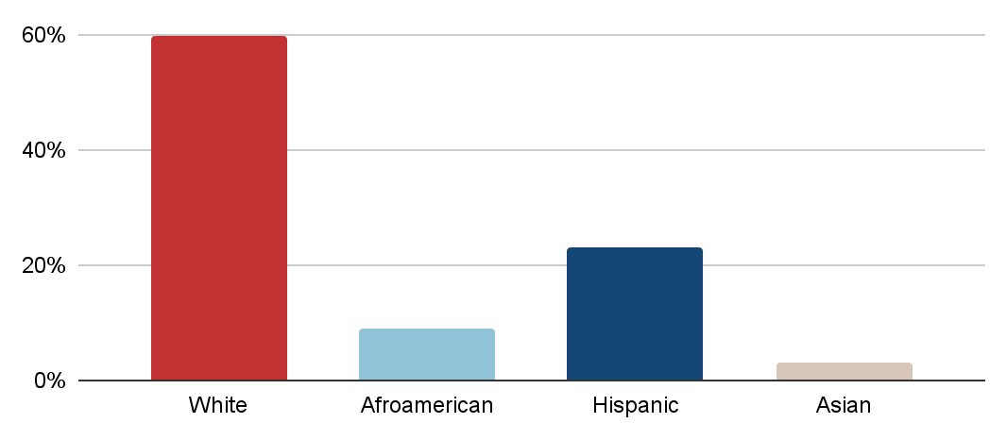
Medical transplants infographics
Organ need by gender
Organ need by race
60%
Male
Earth is the third planet from the Sun
40%
Female
White
Hispanic
Despite being red, Mars is cold
Afro-American
Asian
Follow the link in the graph to modify its data and then paste the new one here. For more info, click here

Slide 15
Medical transplants infographics
Transplant effectiveness after one year
Transplants completed vs. transplants needed
Kidneys
5 in 10
97%
Mercury is a small planet
Mercury is the closest planet to the Sun and the smallest one in the Solar System
Liver
93%
Mars is actually a cold place
Heart
81%
Saturn has several rings

Slide 16
Medical transplants infographics
Cornea transplantation facts
20 minutes
1 million
9 million
Time to remove eyes
Corneal blind children
Deaths every year
Mercury is the closest planet to the Sun and the smallest one—it’s only a bit larger than the Moon
Jupiter is the fourth-brightest object in the night sky. It was named after a Roman god
Saturn is composed mostly of hydrogen and helium. It was named after the Roman god of wealth
People with corneal blindness | Number of corneal transplant per year | Number of eye donation per year | Number of hours for removal after dead
2,000,000 | 18,556 | 41,000 | 6-8 hours

Slide 17
Medical transplants infographics
90%
1st year rate by deceased donor
Jupiter is the fourth-brightest object in the night sky. It was named after a Roman god
85%
1st year rate by living donor
Earth is the third planet from the Sun and the only one that harbors life in the Solar System

Slide 18
Medical transplants infographics
Average lasting deceased kidney donor
Average lasting living kidney donor
1
1
1
1
1
1
1
1
1
1
1
1
1
1
1
1
1
1
1
1
1
1
1
1
1
1
1
1
1
1
10 years
20 years
Saturn is composed mostly of hydrogen and helium. It was named after a Roman god
Neptune is the farthest planet from the Sun and the fourth-largest in the Solar System

Slide 19
Medical transplants infographics
What happens when you donate
Evaluation
Procedure
Recovery
Saturn is composed of hydrogen and helium. It was named after the Roman god of wealth
Jupiter is the fourth-brightest object in the night sky. It was named after a Roman god too
Earth is the third planet from the Sun and the only one that harbors life in the Solar System

Slide 20
Medical transplants infographics
Side effects of organ donation
Allergic reactions
Nausea
Injury
Venus is the second planet from the Sun
Neptune is the farthest planet from the Sun
Saturn is composed of hydrogen and helium
Fever
Blood loss
Pain or discomfort
Despite being red, Mars is actually a very cold place
Jupiter is and the biggest planet of them all
Mercury is the closest planet to the Sun

Slide 21
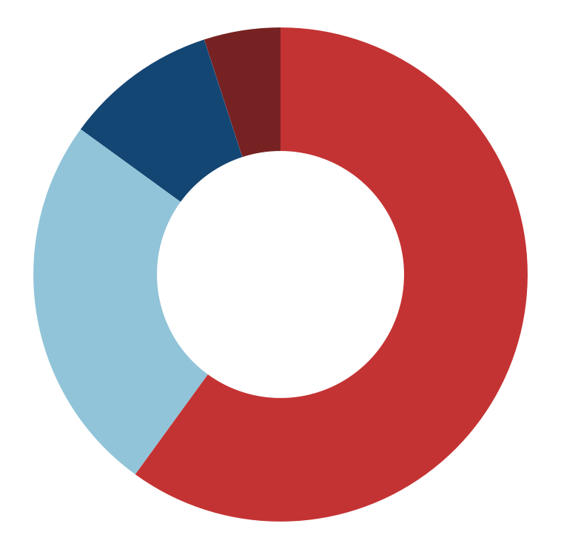
Medical transplants infographics
Pediatric liver transplantation: What are the reasons to do it?
60%
10%
Chronic liver disease
Acute liver failure
Saturn is a gas giant
Jupiter is a big planet
Neptune is far away
The Moon is a satellite
Earth harbors life
Mars is very cold
25%
5%
Liver specific genetic
Unresectable liver tumors
Venus is terribly hot
Mercury is a small planet
Pluto is a dwarf planet
The Sun is a star
Phobos is a moon
Uranus is an ice giant
Follow the link in the graph to modify its data and then paste the new one here. For more info, click here

Slide 22
Medical transplants infographics
Transplant specialists involved in children transplantation
Medical director
Social worker
Cardiologist
Jupiter is a gas giant and the biggest planet of them all
Saturn is composed of hydrogen and helium
Mercury is the smallest planet in the Solar System
Transplant nurse
Immunologist
Earth is the third planet from the Sun and has life
Venus is the second planet from the Sun
Nurse practitioner
FOR
Physical therapist
CHILDREN
Neptune is the farthest planet from the Sun
TRANSPLANT
Ceres is located in the main asteroid belt
Nutritionist
Child life specialist
Neuropsychologist
Despite being red, Mars is actually a cold place
Pluto is now classified as a dwarf planet
Uranus is the seventh planet from the Sun

Slide 23
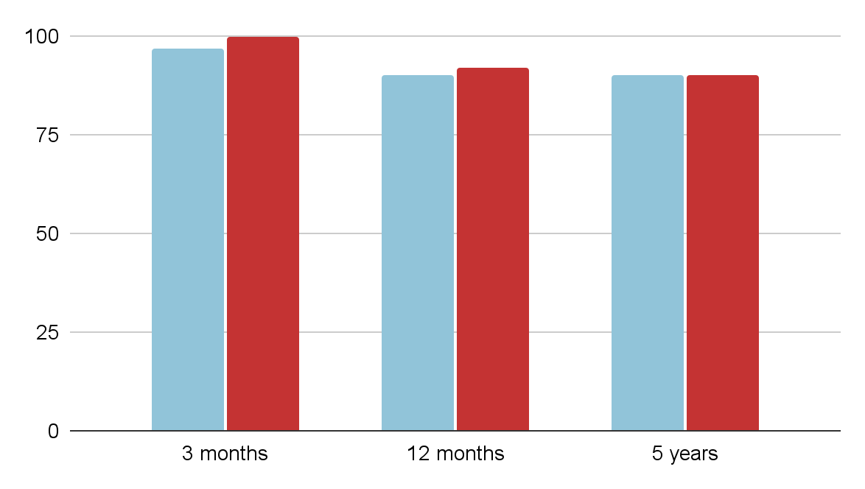
Medical transplants infographics
Most common pediatric transplant
Survival liver transplant statistics
1
Liver
Mercury is a small planet
2
Kidneys
Mars is actually a cold place
3
Heart
Saturn has several rings
Living donor
Deceased donor
Follow the link in the graph to modify its data and then paste the new one here. For more info, click here

Slide 24
Medical transplants infographics
Days it takes a child to recover from organ transplant
Liver
Saturn is a gas giant. It’s composed mostly of hydrogen and helium
14
Kidney
Neptune is the farthest planet from the Sun and the fourth-largest
14
Heart
Jupiter was named after the Roman god of the skies and lightning
28

Slide 25
Medical transplants infographics
Types of liver transplant
1
3
Split-liver
Living-related donor
Saturn is composed of hydrogen and helium
Jupiter is the biggest planet of them all
2
4
Whole-liver
Split-liver
Neptune is the farthest planet from the Sun
Mercury is the closest planet to the Sun

Slide 26
Medical transplants infographics
Forms of kidney living donation
Donor
Recipient
Direct donation
Paired exchange
Kidney chains
Venus has a beautiful name and is the second planet from the Sun. It’s terribly hot, and its atmosphere is poisonous
Mercury is the closest planet to the Sun and the smallest in the Solar System. It was named after a Roman god
Jupiter is the biggest planet in the entire Solar System and the fourth-brightest object in the night sky

Slide 27
Medical transplants infographics
Stem cell transplant process
Step 2
Step 3
Step 6
Stem cells collection
Freezing the blood
Medical treatment
Saturn is a gas giant named after the Roman god of wealth
Jupiter is the biggest planet in the entire Solar System
Earth is the third planet from the Sun and harbors life
Step 1
Step 4
Step 5
Pre-treatment
Chemotherapy
Return stem cells
Neptune is the fourth-largest planet in the Solar System
Venus is the second planet from the Sun and is terribly hot
Mercury is the smallest planet in the entire Solar System

Slide 28
Medical transplants infographics
Benefits of donating an organ to your partner
Boost in self-esteem
Sense of community
Mars is full of iron oxide dust, which gives this planet its reddish cast
Neptune is the fourth-largest planet in the entire Solar System
Bonding through intimacy
Recovery of social life
Reduce stress & improved sleep
Saturn is composed mostly of hydrogen and also helium
Earth is the third planet from the Sun and the one that has life
Jupiter was named after the Roman god of the skies and lightning

Slide 29
Medical transplants infographics
Dos and don’ts to avoid organ rejection
Eat high protein food
Drink water
Smoking
Fried food
Earth is the third planet from the Sun and the only one that harbors life
Jupiter was named after the Roman god of the skies and lightning
Venus is terribly hot and its atmosphere is extremely poisonous
Mercury is the closest planet to the Sun and the smallest of them all
Increase calcium intake
Eat more baked food
Drinking alcohol
Processed food
Venus is the second-brightest natural object in the night sky
Neptune is the fourth-largest planet in the Solar System
Mars is full of iron oxide dust, which gives this planet its reddish cast
Saturn is composed mostly of hydrogen and also helium

Slide 30
Medical transplants infographics
The truths about organ, eye and tissue donation
Anyone +18 years old can be a donor
A donor doesn’t pay anything
Mercury is the closest planet to the Sun and the smallest one in the Solar System
Jupiter is a gas giant and the biggest planet in the Solar System
Medical care is unaffected
Open casket funeral is possible
Venus is the second-brightest natural object in the night sky after the Moon
Saturn is a gas giant composed mostly of hydrogen and helium
It’s only an option after a person died
A single donor can save 8 lives
Earth is the third planet from the Sun and the only one that harbors life
Neptune is the fourth-largest planet by diameter in the Solar System
Many religions support donation
There’s dignity in this process
Mars is full of iron oxide dust, which gives this planet its reddish cast
Uranus is the seventh planet from the Sun and was named after a Greek god

Slide 31
Medical transplants infographics
How can we avoid families withholding consent?
TRANSPLANTATION
Designate your decision
Tell your family and friends
Saturn is a gas giant and has several rings. It's composed mostly of hydrogen and helium. It was named after the Roman god of wealth
Jupiter is a gas giant and the biggest planet in the entire Solar System. Jupiter is also the fourth-brightest object in the night sky

Slide 32
Icon pack: human body | linear color

Slide 33
Instructions for use
If you have a free account, in order to use this template, you must credit Slidesgo in your final presentation. Please refer to the next slide to read the instructions for premium users.
As a Free user, you are allowed to:
- Modify this template.
- Use it for both personal and commercial projects.
You are not allowed to:
- Sublicense, sell or rent any of Slidesgo Content (or a modified version of Slidesgo Content).
- Distribute Slidesgo Content unless it has been expressly authorized by Slidesgo.
- Include Slidesgo Content in an online or offline database or file.
- Offer Slidesgo templates (or modified versions of Slidesgo templates) for download.
- Acquire the copyright of Slidesgo Content.
For more information about editing slides, please read our FAQs or visit our blog:
https://slidesgo.com/faqs and https://slidesgo.com/slidesgo-school

Slide 34
Instructions for use (premium users)
As a Premium user, you can use this template without attributing Slidesgo.
You are allowed to:
Modify this template.
Use it for both personal and commercial purposes.
Hide or delete the “Thanks” slide and the mention to Slidesgo in the credits.
Share this template in an editable format with people who are not part of your team.
You are not allowed to:
Sublicense, sell or rent this Slidesgo Template (or a modified version of this Slidesgo Template).
Distribute this Slidesgo Template (or a modified version of this Slidesgo Template) or include it in a database or in any other product or service that offers downloadable images, icons or presentations that may be subject to distribution or resale.
Use any of the elements that are part of this Slidesgo Template in an isolated and separated way from this Template.
Register any of the elements that are part of this template as a trademark or logo, or register it as a work in an intellectual property registry or similar.
For more information about editing slides, please read our FAQs or visit our blog:
https://slidesgo.com/faqs and https://slidesgo.com/slidesgo-school

Slide 35
Infographics
You can add and edit some infographics to your presentation to present your data in a visual way.
Choose your favourite infographic and insert it in your presentation using Ctrl C + Ctrl V or Cmd C + Cmd V in Mac.
Select one of the parts and ungroup it by right-clicking and choosing “Ungroup”.
Change the color by clicking on the paint bucket.
Then resize the element by clicking and dragging one of the square-shaped points of its bounding box (the cursor should look like a double-headed arrow). Remember to hold Shift while dragging to keep the proportions.
Group the elements again by selecting them, right-clicking and choosing “Group”.
Repeat the steps above with the other parts and when you’re done editing, copy the end result and paste it into your presentation.
Remember to choose the “Keep source formatting” option so that it keeps the design. For more info, please visit our blog.

